Slide 1
Give Your Users a Diamond Status Authentication Experience

Slide 2
Do you consider consuming an audiobook reading?
Notes:
Before we get started, to get the brain muscles moving, I have a question for you all; which we’ll come back to in the end. [question] take some time, think about it and we’ll come back to the question later on.

Slide 3
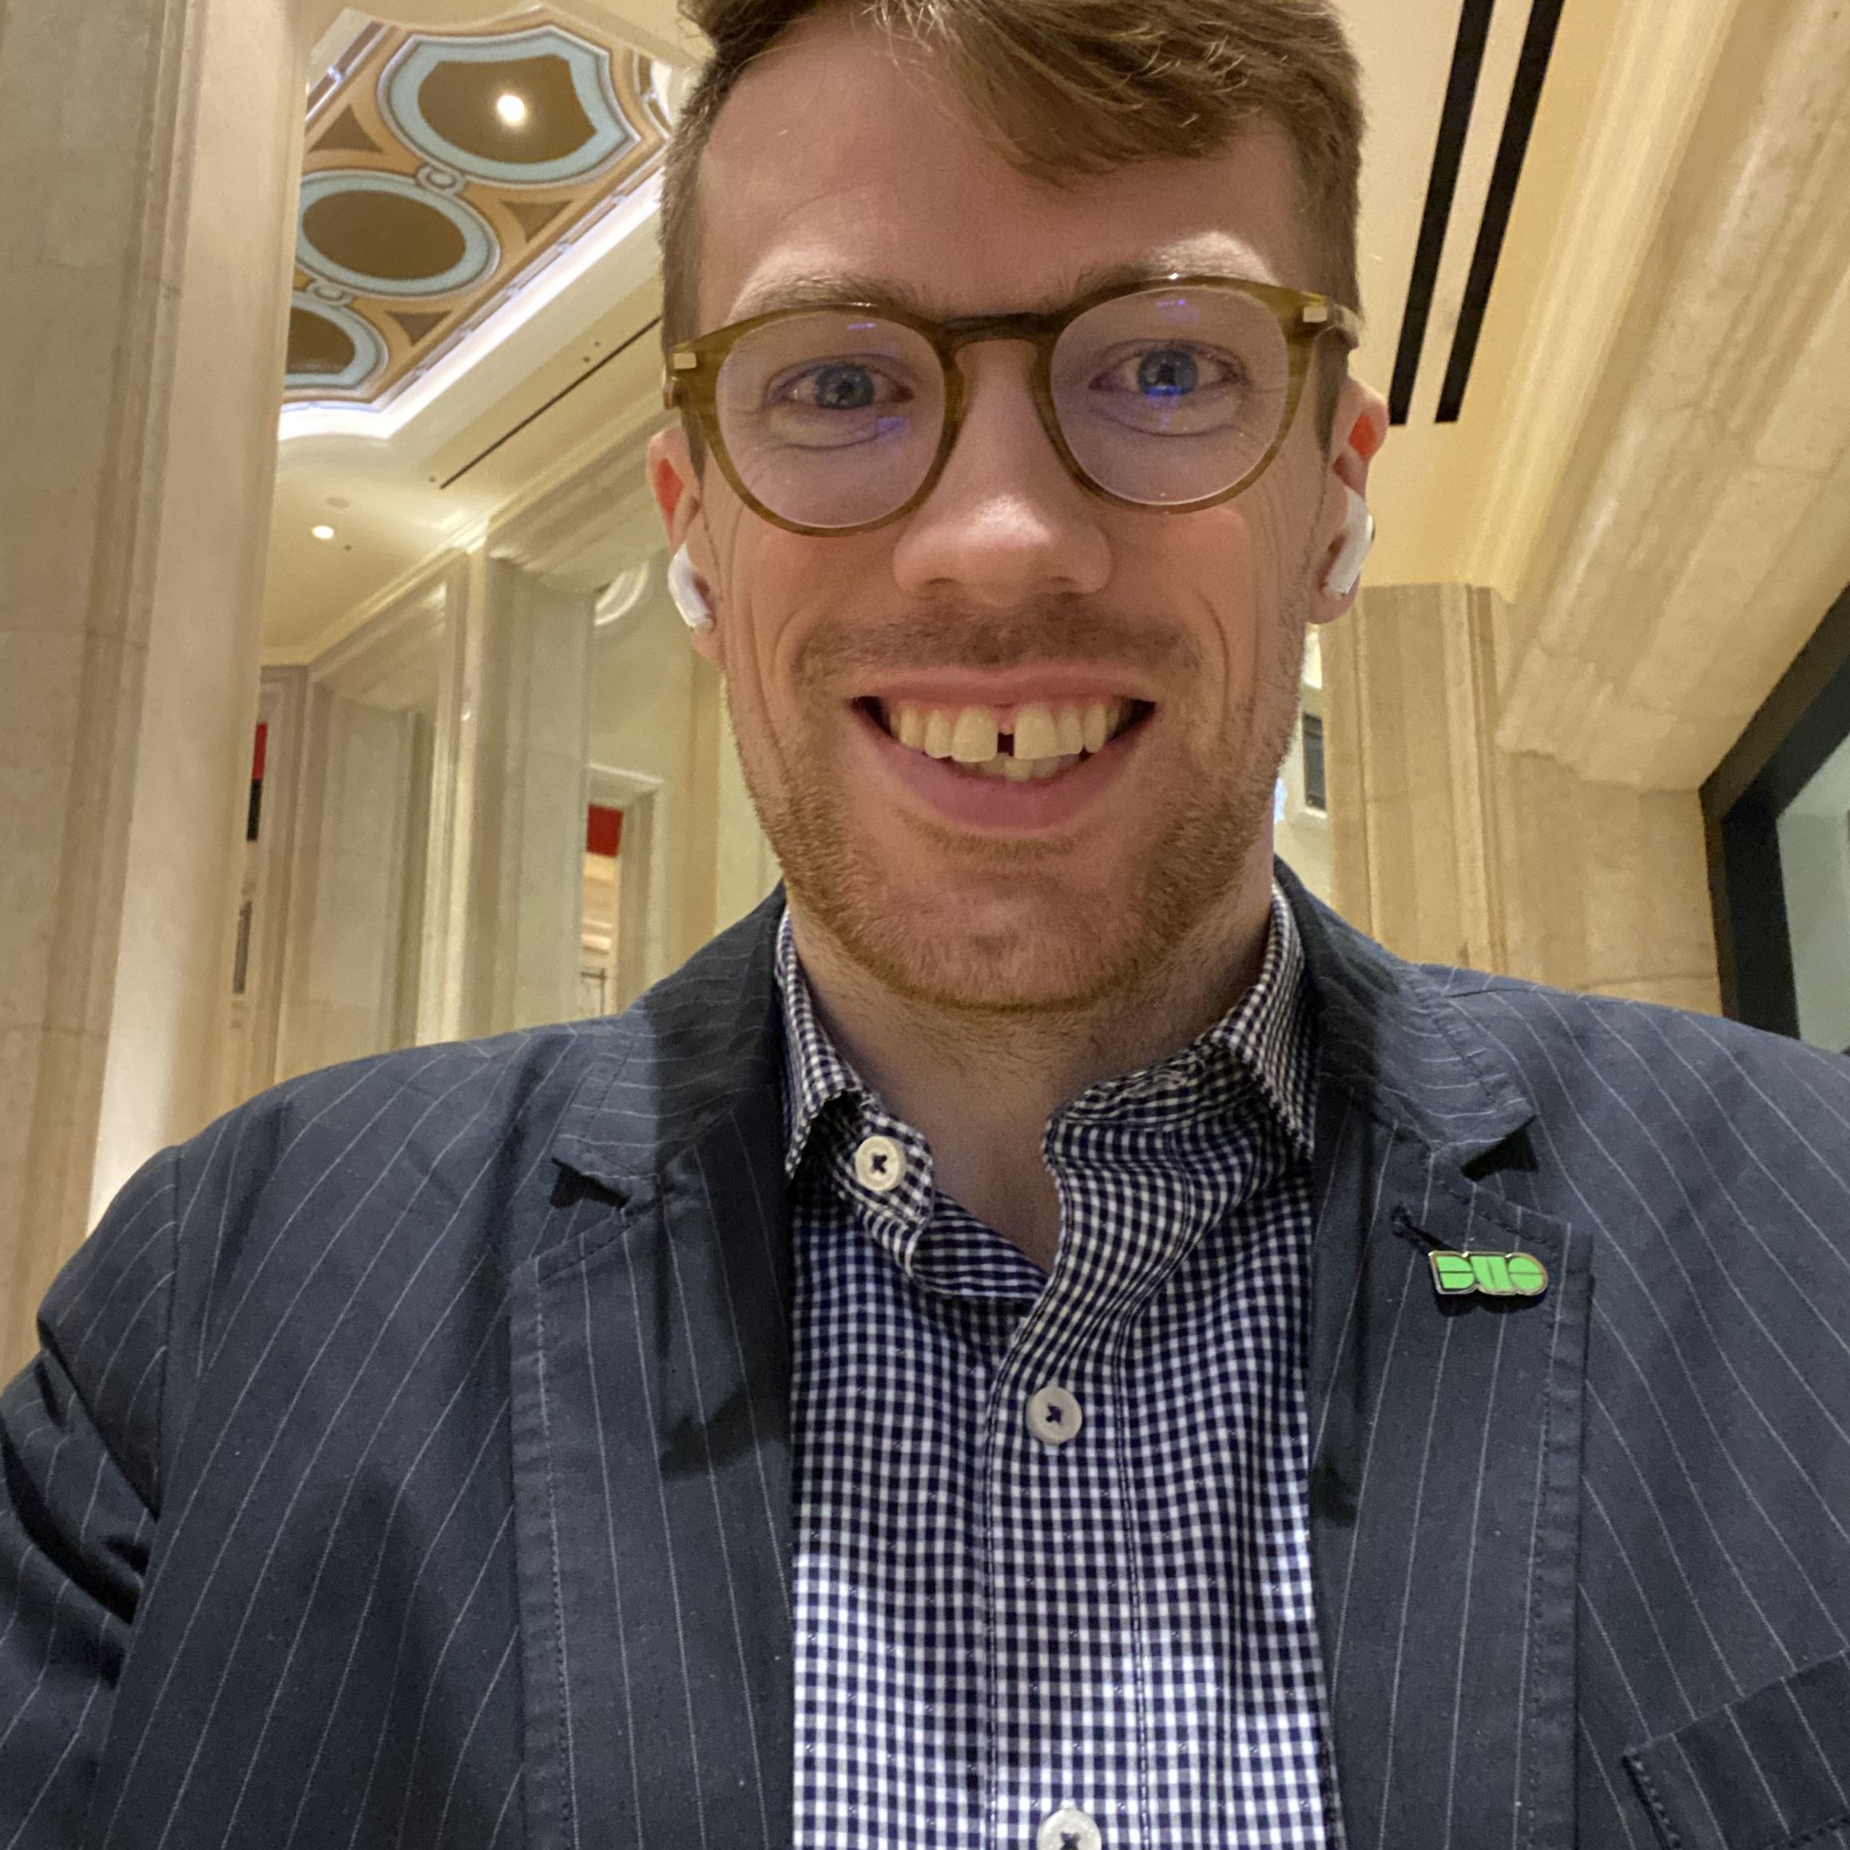
Chris
Anderson
Sr Principal PM
Cisco Duo

Slide 4
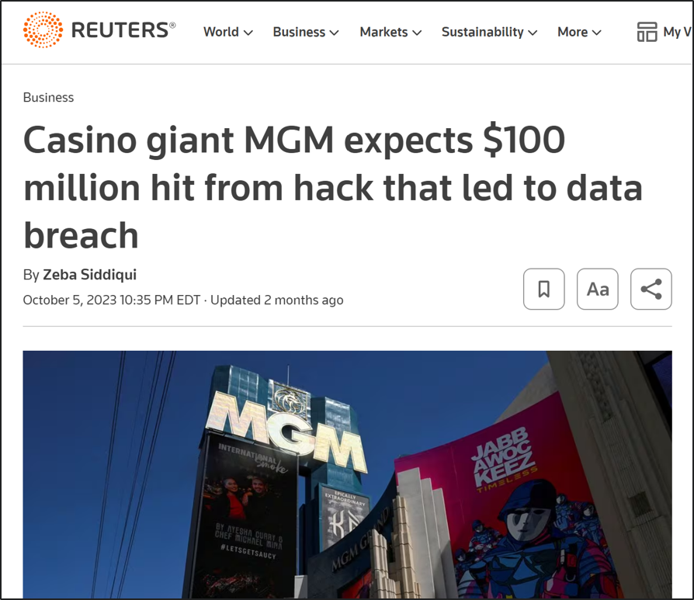
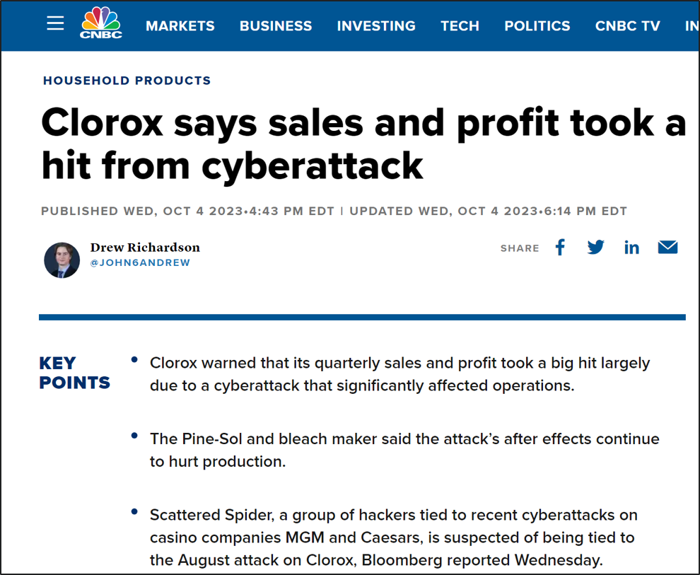
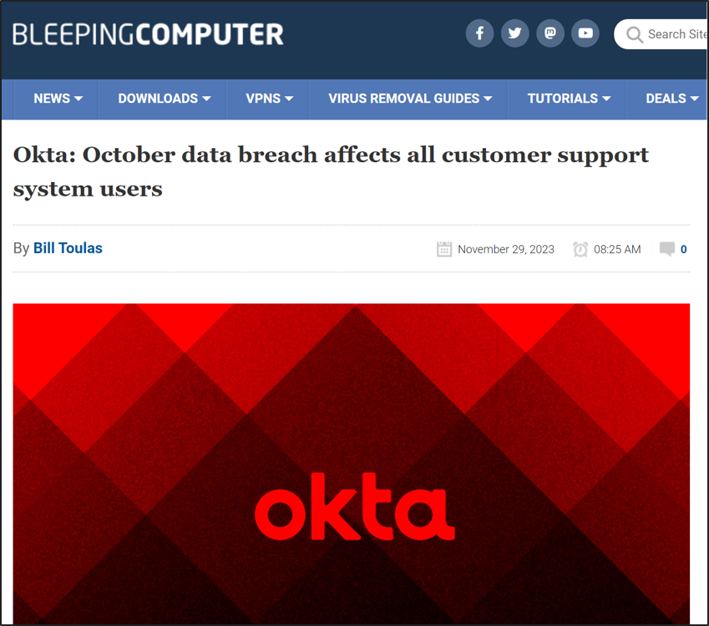
The State of Authentication Today
Today’s attacker is
remote
on a personal endpoint
not on your network
breaching your users
“professional”
Notes:
We have a couple back slides to set the lay of the land. Attacks on authentication and even more broadly, identity services are rampant. If this is new news to any of you in this room, then i regret to inform you that there isn’t a slot machine in this room. Let’s get back to identity attacks – which btw you can check out my colleague Ted Kietzman’s session tomorrow at 3:10 titled “Groundhog Day, but with Compromised Credentials” who will dig more into the trends of these attacks, but for this session, the thing i want us all to focus on is that beyond these attacks continuing to grow AND be affective, the actual advisory approach is what i want call your attention to. THey are remote, on a personal endpoint, not on the corporate networking, breaching your users and being “professional”.

Slide 5
The State of Authentication Today
Today’s attacker is
remote
on a personal endpoint
not on your network
breaching your users
“professional”
Notes:
One level deeper, Remote, on a personal endpoint and not on the corporate network also describes A LARGE portion of our own workforce employees.

Slide 6



Raise the Bar against Credentials Compromise
Trusted Users
Trusted
Devices
Trusted Context
+
+
Broadest application coverage with traditional MFA
Diverse set of authenticators
Simple for both admins & users
Trust only securely registered and managed devices
Manage endpoint posture
Easily deploy to contractors & third-parties
Visibility into identity centric telemetry
Understand baseline activity
React to anomalies and identity threats
Notes:
Which means our way to protect against these attacks, from an authentication point of view again, is by focusing on the user, devices and context. However, the outcome, many times, is that the experience for our workforce employees has gotten worse over the years in an effort to always verify the user actually is who they say they are and coming from a safe device and I’m here to say point blank that while that was the right move early on, we can do better as an industry. And our users deserve for us to do better.

Slide 7
To illustrate the problems in the authentication space, let’s use the example of an airport
Notes:
So let’s dig into what i mean, starting by illustrating the problems in the authentication space, by using an example almost everyone in this room experienced this week - airline travel.

Slide 8
Bob needs to catch a flight.
Notes:
Bob needs to catch a flight, well that seems easy or daunting depending on your level of airline travel.

Slide 9
Ticket Counter
Notes:
First Bob needs to go to the ticket counter - which as many of us know, is PAINFUL, waiting in a long line, continuing to look at your watch hoping you dont miss your flight.

Slide 10
TSA
Ticket Counter
Notes:
Bob then goes through the never ending line of TSA - again looking at his watch.

Slide 11
TSA
Ticket Counter
Snacks
Notes:
He notices he has time so he stops to get over priced snacks

Slide 12
TSA
Gate
Ticket Counter
Snacks
Notes:
Only to end up at his gate, being self-herded like sheep hoping to be the first one in line when your zone is called

Slide 13
TSA
Gate
Ticket Counter
Snacks
Plane Seat
Notes:
To then get on the plane to realize there is no over head ben space left at your middle seat near the end of the plane. By now, Bob is questioning if his final destination is worth all this pain and hassle getting there.

Slide 14
In the digital space, Bob needs authentication to several services.
Notes:
So how is this synonymous to ones daily experience at work accessing their corporate applications?

Slide 15
Anatomy of a Regular Workday
Authentication Experience
Desktop OS Login
Web Browser Login
Different Web Browser Login
Outlook Client Login
VPN Login
Notes:
Well, let’s look at what a regular workday experience is.
Now remember to our earlier slides - many users these days are remote AND not on the corporate network all day - maybe even on a BYOD device.

Slide 16
Anatomy of a Regular Workday
Authentication Experience
Desktop OS Login
Web Browser Login
Different Web Browser Login
Outlook Client Login
VPN Login
Desktop Login
Web App Login
Web App Login
Email Login
VPN Login
Notes:
So you log into your Desktop OS - maybe passwordles, maybe no, maybe with MFA on top of your username and password. From their, you open browser to access an application and BAM, username / password (hopefully with an SSO provider) & MFA. If you are like me and are a Mac user who prefers Safari, sometimes when I go to access a certain unnamed application it “works best’ in Chrome, so you access chrome and BAM login again because those IdP and mFA sessions dont cross browsers. Realize you forgot to open Outlook, so you open the native app and you guess it, BAM login again as it’s an embedded browser and you only have an IdP & MFA session with Safari and Chrome. You then realize you need to look up customer data in snowflake or similar and thus you need to access the VPN…well….lastly, login again. By now, you have been at your desk for what 5-10 mins and you’ve logged (fully - interactively) in 5 times…I’d rather wait in a TSA line. Now we’ve help improve this experience, some with Passkeys and PWL, BUT adoption of those are still relatively low and even when they are adopted I would be prompted for TouchiD or my mac or windows hello multiple times and some of these, like the embedded VPN bit, may not support WebAuthn and thus you resort to username / password and MFA

Slide 17
What is the Diamond Status Experience?

Slide 18
Lee needs to catch a flight.

Slide 19
Priority Check-in

Slide 20
Priority Check-in
TSA Pre & CLEAR

Slide 21
Priority Check-in
TSA Pre & CLEAR
Lounge

Slide 22
Priority Check-in
TSA Pre & CLEAR
Lounge
Arrive Last / Board First

Slide 23
Priority Check-in
TSA Pre & CLEAR
Lounge
Arrive Last / Board First
First Class

Slide 24
In the digital space, Lee needs authentication to several services.
Notes:
So what does Lee’s digital experience look like as a Diamond Status member?

Slide 25
Let’s frustrate attackers, not users
Authentication Experience
Desktop OS Login
Web Browser Login
Different Web Browser Login
Outlook Client Login
VPN Login

Slide 26
Let’s frustrate attackers, not users
Authentication Experience
Desktop OS Login
Web Browser Login
Different Web Browser Login
Outlook Client Login
VPN Login
Diamond Status User Authentication Experience
Secure Passwordless Desktop Login
Log in once into the OS with trusted and secure sessions persisting across all web and local applications without requiring additional authentication by the user.
Notes:
Talk about about how SSO doesn’t solve for these different browsers, embedded browsers, connecting trust between OS. Broaden brokering the trust even further

Slide 27
Airport security coordination
Notes:
Behind the scene, you have the Federal Gov’t with TSA & FBI & Air marshals coordinating with 3rd parties like CLEAR, the airlines and the airport itself on things like no fly lists.

Slide 28
But, react to risk dynamically when appropriate
Diamond Status User Authentication Experience
Secure Passwordless Desktop Login
Notes:
Just like airport security coordination, with advances in Identity with the likes of ITDR, standards like Shared Signals Framework, and more, we are able to continuously ensure users are secure

Slide 29
But, react to risk dynamically when appropriate
Diamond Status User Authentication Experience
Secure Passwordless Desktop Login
Dynamically react to changes in risk post-authentication and respond with graduated enforcement from self-remediation to user lockout.
Post-Authentication Risk Assessment
Secure Passwordless Desktop Login
Indicator of Risk
Notes:
And if their risk changes at all, we can immediately respond, whether that’s a self-remediation based enforcement or a full user lockout.
Diamond status are getting the coach experience and the hackers are getting diamon status. Over authenticating good, under authenticating bad.

Slide 30
How do we make this a reality?

Slide 31
It takes all of us!
Organizationally
Choosing the right IAM strategy, software, services
Focus on User, Device and Context based solutions
Staying current & up-to-date
Focusing not just on outcomes but also on the journey towards those outcomes
Community
Help move standards forward so we can share security context (airport security!)
Open APIs
Collaboration knowing that solving the problem is just as important as winning deals
Notes:
The reality is, it’s already here, but to varying levels of experiences and capabilities
To achieve this we need to focus on two core areas: (1) Choosing the right IAM strategy, software, services, for the vendors in the room – helping move standards forward, sharing security context (like what happens at airports), being a community (2) A shift needs to occur as well. A LOT of the times we focus on the outcome (Getting to Vegas from RDU) – in the IAM space it’s that Bob or Lee can access concur and expense their travel, it’s security and ensuring bad actors can’t gain access, compliance regulations, insurance, audits, etc; HOWEVER, just as important is the journey we send our users down. Just like your if desired outcome in life is to live on a secluded island where YOU choose when to interact with society, that outcome is truly depicted based on the journeys you choose throughout your life. Getting to a Diamond Status experience / journey for our users helps us to achieve our desired outcomes. Most of us don’t like to fly, not because of where we are going, but because of the journey to get there. We need to get to a world where the journeys we create for our end users as part of our IAM strategy , is so delightful that they help us get to the outcomes we need to achieve. We’ve made tremendous strides over the last few years with Passkeys but that’s a portion of the journey and I encourage everyone to continue with this mentality as we continue to tackle ALL the experiences users go through.
Look at what your existing IdP or authentication vendor provides today, this capability is becoming common place. consider carefully if your auth vendor supports non domain joined machines, if it relies on presence on the network, if it supports mac and windows
Recognize you might need to install an agent as part of authentication

Slide 32
Do you consider consuming an audiobook reading?
Notes:
To me, the answer doesn’t really matter – it’s the journey you embarked to get to the outcome – consuming a book. You may have used audiobooks during a workout, in a setting where you couldn’t physically hold a book / look at your phone/tablet, whatever it may be so long as the journey was delightful for you; THAT’s just as important as consuming the actual book.

Slide 33
See me at the Cisco booth (#1301) to discuss

